Slide 1
Wallace’s work in K-12 education:
Evidence on school leadership, summer learning, and afterschool
The Wallace Foundation:
Will Miller, President
Kenneth Austin, Vice President, Policy Engagement
Rotunda Floyd-Cooper, Vice President, Education Leadership
Meeting with the U.S. Department of Education
September 6, 2023

Slide 2

About The Wallace Foundation
Philanthropic legacy of DeWitt and Lila Wallace, founders of Reader’s Digest
Independent, non-partisan private foundation
We believe children in America should have the opportunities and supports necessary to reach their full potential as human beings regardless of where they live, their background, race, or identity
We work with partners to develop and share evidence-based, practical approaches to strengthen school leadership, summer learning and afterschool, as well the non-profit arts
Notes:
About Wallace
Public policy principles
Include goals for meeting:
We are here today because of our work in education. We seek to improve equitable opportunities and outcomes through long-term work in areas including:
School leadership, summer learning and afterschool
We hope the non-partisan research we’ve commissioned can continue to be a helpful resource to policymakers

Slide 3

Our strategic approach to initiatives
Understand the Context
Engage with the external environment to identify unanswered questions (or knowledge gaps)
and sector interest
Catalyze Broad Impact
Dual Goals
Improve practice
and policy nationwide
Broad
Benefits
Local
Benefits
Generate Improvements and Insights
Build promising new approaches and new evidence/knowledge
3

Slide 4
Our public policy engagement principles
Share only reliable, credible information and evidence – inclusive of the full range of evidence: “We say more only as we know more”
When we recommend policies and practices, we support flexible approaches that allow for adaptation to local context
Remain nonpartisan and in full compliance with the law, in letter and spirit, at all times

Slide 5
Our work in education over the past 10 years
School Leadership, afterschool and summer learning
School Leadership only
Afterschool and/or summer learning only

Slide 6
Our support for pandemic recovery
School leadership:
  Created the American Rescue Plan Network of 78 districts using ARP funds to strengthen principal preparation and support
  In Texas, expanded support for principal preparation program redesign from 8 to 24 universities
  Extended the 11-state team ESSA Leadership Learning Community (undertaking collaborative efforts to develop and support principals) for two more years, with each team enacting activities to respond to the pandemic
  Produced guide on using federal funds to support school leadership
Summer learning and afterschool:
  Launched the District Summer Learning Network in 120 districts in 15 states to encourage adoption of evidence-based practices in summer learning
  In Texas, support for evidence-based practices in summer learning for 75 districts
  Funded National Summer Learning Association and Council of Chief State School Officers to create State Summer Learning Network with nine states
  Produced guide on using federal funds for summer learning and afterschool

Slide 7
School leadership

Slide 8
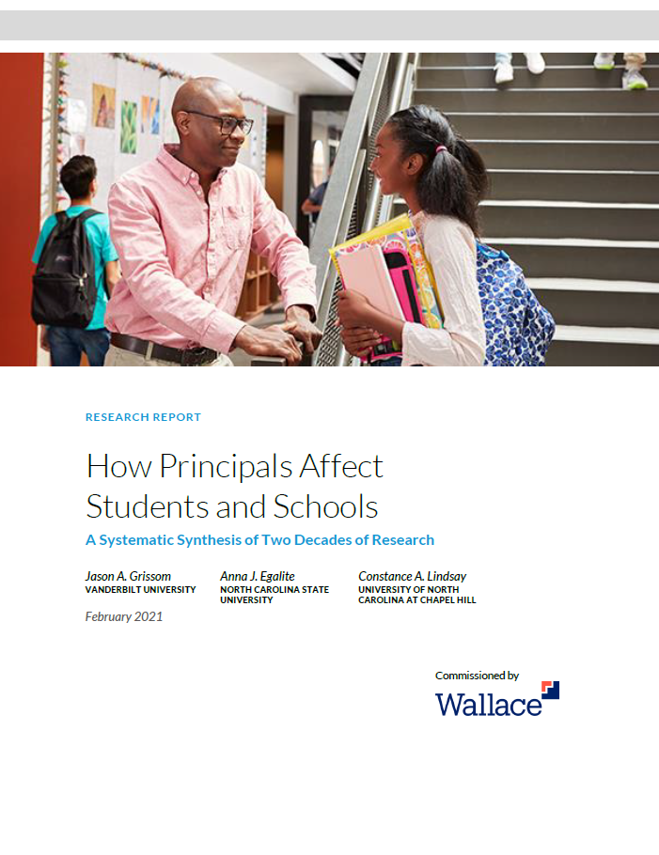
Effective principals are crucial for students, staff and schools
Effective principals are key to the success of school improvement efforts
Effective principals linked to improved student achievement, better student attendance, less exclusionary discipline, lower teacher turnover and higher teacher satisfaction
Principals affect an entire school
  “It is difficult to envision an investment with a higher ceiling on its potential return than a successful effort to improve principal leadership.”
Four key behaviors of effective principals identified – with emerging insights on how they can be carried out with an equity lens
  Instructionally-focused interactions with teachers, building a productive school climate, facilitating collaboration and professional learning, managing personnel and resources strategically.
Source: How Principals Affect Students and Schools: A Systematic Synthesis of Two Decades of Research, Grissom, et al., Wallace, 2021; School Leadership Interventions Under the Every Student Succeeds Act: Evidence Review, Updated and Expanded, Herman, et al., RAND, 2017. Principal Pipelines: A Feasible, Affordable, and Effective Way for Districts to Improve Schools, Gates, et al., RAND, 2019; How Leadership Influences Student Learning– Wallace Foundation, Leithwood, et al., 2004.
Notes:
We have worked with 174 districts, states, universities on principals as a lever for school improvement, and on systematic approaches to develop and support them
We have learned that effective school leadership is crucial, and we have evidence showing us how to get there
In particular, we understand the critical role of the principal: for student and staff success, as well as for teacher retention

Slide 9
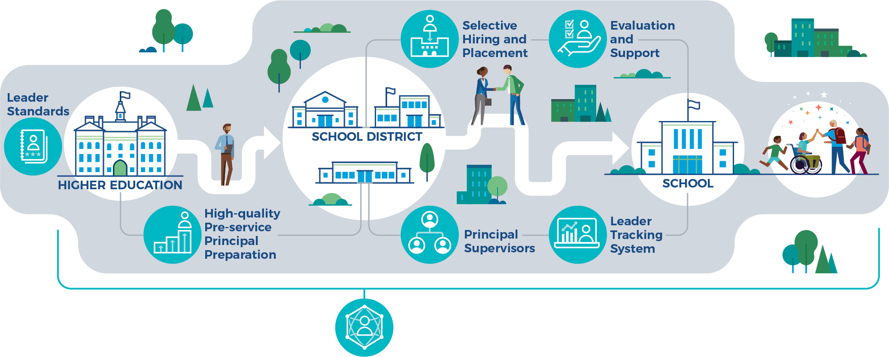
Comprehensive, aligned principal pipelines:
An evidence-based approach to developing and supporting principals and improving student achievement
Principal pipelines – a proven, comprehensive, aligned approach to developing and supporting principals
  Selective hiring, aligned support and evaluation
  Partnerships with university preparation programs (which can redesign programs to match current evidence)
Payoff: In six large districts, benefits for math and reading in elementary schools, math in high schools, including in lowest quartile of schools.
  After three years, schools in pipeline districts outperformed their comparison schools by 5 percentile points in reading and 2.3 percentile points in mathematics.
  RAND found the efforts “provided districts with larger gains for fewer resources spent per student than is typically found in research.”
“We found no other comprehensive district-wide initiatives with demonstrated
positive effects of this magnitude on achievement.”
  --Principal Pipelines: A Feasible, Affordable, and Effective Way for Districts to Improve Schools, RAND, 2019
Source: Strong Pipelines, Strong Principals: A Guide for Leveraging Federal Sources to Fund Principal Pipelines, Turnbull, et al., The Wallace Foundation, 2021; Principal Pipelines: A Feasible, Affordable, and Effective Way for Districts to Improve Schools, Gates, et al., RAND, 2019: States as Leaders, Followers, and Partners: Lessons from the ESSA Leadership Learning Community and the University Principal Preparation Initiative, Paul Manna, 2022
Notes:
“…when states embrace well-crafted standards and make them relevant by tying them to other policy levers that bear on principal training, licensing, support, and evaluation…they can foster coherence and quality and increase the chances that all students are well-served.”
- Paul Manna
For NC/Foxx meeting, note that North Carolina State University has worked with local districts to create specific programs for urban, suburban and rural districts

Slide 10
Our current work: The Equity-Centered Principal Pipeline Initiative (2021-2027)
Guiding question
Research studies
“Given that comprehensive, aligned principal pipelines have been demonstrated to benefit student achievement, and given the key role of principals in advancing equity, this initiative seeks to learn whether and how districts can develop and implement comprehensive, aligned principal pipelines who can help bring a district’s vision of equity to fruition.”.”
Central office. A three-year study of the districts’ central office led by University of Texas at Austin researchers with others from the University of Iowa, University of Houston and California State Polytechnic University-Pomona.
Implementation study and tool. A six-year implementation study that includes creating a tool to measure equity-centered leadership. Led by University of Wisconsin-Madison researchers, with researchers from UCLA, Teachers College, American Institutes of Research and WestEd​.
Research use study. Five-year study of research use and research-practice partnerships led by University of Colorado Boulder researchers.
The Wallace Foundation believes that equity means that fairness is embedded in the systems, structures, and practices of our society, giving all people the opportunity and supports necessary to reach their full potential as human beings. Since we believe what it takes to achieve equity depends upon local context and history, we never impose a definition of equity on our grantees. Instead, each grantee defines the term for themselves.

Slide 11
8 districts in the Equity-Centered Principal Pipeline Initiative
Baltimore City Public Schools, Maryland: With local groups, Morgan State University, Towson University, and the Maryland State Department of Education
Columbus City, Ohio: With local groups, Ashland University, Ohio State University, and the Ohio Department of Education
District of Columbia Public Schools, District of Columbia: With ​local groups, Howard University, George Washington University
Fresno Unified School District, California: With local groups, San Diego State University, National University, and the California Department of Education
Jefferson County School District, Kentucky: With local groups, Spalding University, University of Louisville, and the Kentucky Department of Education
Portland Public Schools, Oregon: With local groups, Portland State University, Lewis and Clark College, the Oregon Teacher Standards and Practices Commission, and the Oregon Department of Education.
San Antonio Independent School District, Texas: With local groups, University of Texas at Austin, University of Texas at San Antonio, and the Texas Education Agency
Winston-Salem/Forsyth County Schools, North Carolina: With local groups, University of North Carolina at Greensboro, Appalachian State University, and the North Carolina Department of Public Instruction

Slide 12
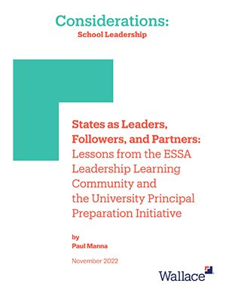
Statewide approaches for supporting principals are emerging
State standards are a powerful, cross-cutting policy lever that, when used in districts and universities, shape specific decisions about training, developing and supporting principals.
When states foster networks that connect districts, universities, and others, creative problem-solving emerges that can enhance the likelihood of principal initiatives succeeding.
States, districts, universities, and others each have comparative advantages that, when realized, can make the most of networked partnerships that advance principal initiatives.
Examples of statewide collaborations:
  Missouri: Using Title II-A set-aside funds, strengthened one of the nation’s most comprehensive statewide principal development initiatives, the Missouri Leader Development System (MLDS) for novice through experienced principals, including for those in low-performing schools. Since 2018, the year-to-year retention rate for Missouri principals in their first three years on the job has grown from 82% to 87% in 2021 – with retention rates for those enrolled in MLDS at a remarkable 98 percent.
  Wisconsin: With the state education agency and state Urban League chapter, superintendents of the state’s “Big 5” urban districts launched the Wisconsin Urban Leadership Institute for principals; cohorts of 25 gain 10 months of professional learning, coaching and networking.
Source: States as Leaders, Followers, and Partners: Lessons from the ESSA Leadership Learning Community and the University Principal Preparation Initiative, Wallace Foundation, 2022; All the Voices: Statewide Collaborations for School Leadership under ESSA, Policy Studies Associates, 2022; Missouri’s Ongoing Effort to Develop Principals Pays Off | The Wallace Foundation.

Slide 13
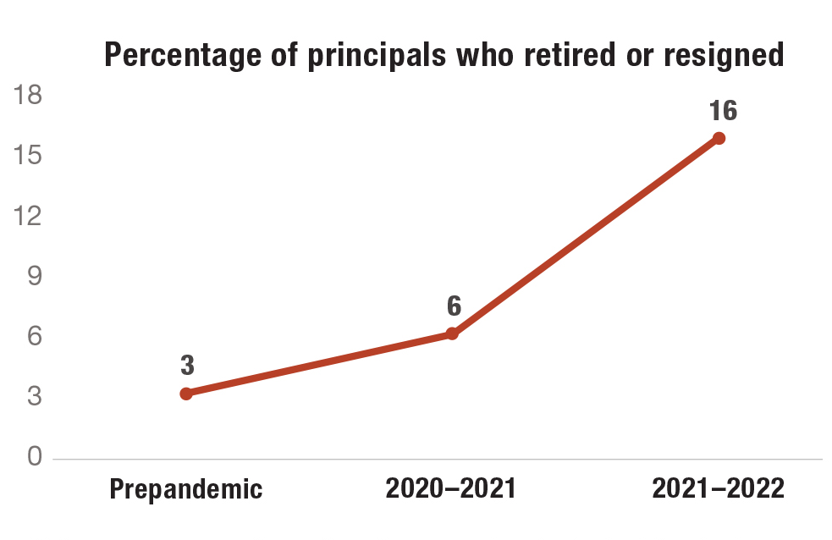
The opportunity: Encourage districts and states include principals in recovery efforts
Given their importance for student success, teacher retention and school success, we believe every school deserves an effective principal
Based on a RAND survey of 300 district and charter network leaders, post-pandemic principal turnover is rising faster than teacher turnover
  Principal turnover reached 16% nationally going into the 2022-23 school year – with turnover highest (21-23 percent) in high-poverty and rural districts
Historically, university-based principal preparation programs have not prepared graduates for the challenge of today’s jobs – fortunately, evidence-based redesign with districts has now been shown to be feasible and we are learning about what is effective.
Ninety percent of medium to large-sized districts see principals as crucial to their efforts. But few medium and large districts have comprehensive and aligned principal pipelines to prepare and support them
Source: Educator Turnover Has Markedly Increased, but Districts Have Taken Actions to Boost Teacher Ranks: Selected Findings from the Sixth American School District Panel Survey | RAND ; Taking Stock of Principal Pipelines: What Public School Districts Report Doing and What They Want to Do to Improve School Leadership, Gates, et al., RAND, 2020. RAND American School District Panel Survey, 2023
Notes:
Principal preparation is getting more attention – but many programs may not be employing evidence-informed practices

Slide 14
How we got here – a 23-year journey
2016-2022
University Principal Preparation Initiative (7 universities)
Research results:
A model for redesigning principal preparation including partnerships with districts
2000-2010
First Generation Ed Leadership Work
15 states/12 districts
2011-2016
Principal Pipeline
Initiative
6 districts
2021-2027
Equity-Centered Principal Pipelines
8 districts
Lessons
Lessons
Research results:
School leadership second only to effective teacher in student outcomes
Research results:
Comprehensive aligned pipelines are feasible, affordable, adaptable and effective;
Large gains in lowest quartile schools

Slide 15
Summer learning and afterschool

Slide 16
Evidence shows learning experiences in and out of school can help young people
High-quality afterschool and summer programs can confer a variety of benefits according to program design
  Academic benefits for reading and math
  Improved school-year attendance and attitudes
  Life skills, including teamwork and persistence
  New experiences and skills
  Future aspirations
  Career readiness
Program quality and skilled staff are common to strong programs and, for summer, planning beginning in January is important
Sufficient duration and attendance are linked to academic outcomes
  Example: Students who regularly attended a five-week voluntary program for two summers showed outperformance equivalent to 19 percent of typical annual growth in language arts and 23 percent of annual growth in math
“Ensuring all young people have access
to a multitude of rich developmental experiences is imperative to their success.”
-- Foundations for Young Adult Success: A Developmental Framework, University of Chicago
Source: The Value of Out-of-School Time Programs, McCombs, et al., RAND, 2017; Shaping Summertime Experiences: Opportunities to Promote Healthy Development and Well-Being for Children and Youth, Sepulveda, et al., National Academies, 2019; Foundations for Young Adult Success: A Developmental Framework, Nagaoka, et al., University of Chicago, 2015. of Chicago, 2015.
Notes:
For more than 20 years, we have worked with districts, community-based organizations, independent researchers and national organizations to develop evidence about benefits of afterschool and summer learning and how to achieve them.
Then talk about what we have learned as noted here

Slide 17
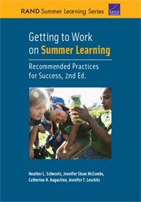
Recommendations for effective academically-focused summer programs
Based on the largest study of summer learning programs to date that included five school districts and their partners, RAND identified these characteristics of high-quality programming tied to academic outcomes for students:
  Five to six weeks program duration with three to four hours of academics per day
  Attendance for at least 20 days
  Inclusion of academics and enrichment
  Early planning, including committing to a program in the Fall
  Continuous improvement
  Recruiting, hiring and preparing effective teachers
  Recruitment of students with focus on consistent attendance
Source: Getting to Work on Summer Learning: Recommended Practices for Success, 2nd Edition, RAND, 2021.

Slide 18
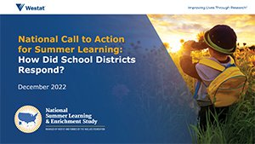
Districts and states are using federal funds to strengthen summer learning
Summer learning is the most common new or expanded approach districts (70%) are taking for pandemic-related recovery, with three-fourths tapping federal funds
  Three quarters of those are focusing on learning recovery
  Thirty out of 37 states reported developing a summer learning and enrichment vision
Source: Districts Continue to Struggle with Staffing, Political Polarization, and Unfinished Instruction, Dilberti, et al., RAND, 2022; A National Call to Action for Summer 2021: How did LEAs Respond, National Summer Learning & Enrichment Study, Westat 2022; A National Call to Action for Summer Learning: How did States Respond, forthcoming, Westat 2023;

Slide 19
The opportunity: Build systems to support quality, access and staffing needs
Given the role of summer learning and afterschool in student engagement and academic success, we believe every student deserves access to high-quality programs.
Equitable access to high-quality programs remains a challenge, despite widespread support from voters and parents
  More than 8 in 10 surveyed agree that afterschool and summer programs are an absolute necessity for their community.
  For every child in an afterschool program, parents say four more would attend if they could
  Sustainment after ARP funds end is a major concern
  49% of district leaders worry about ‘a fiscal cliff’
Workforce shortages are also a major concern
  51% of non-profit providers are ‘extremely concerned’ about finding staff
States may benefit from additional support and capacity building as they work to sustain summer learning programs.
Source: Parents-and-Voters-Support-Afterschool-and-Summer-for-All, Afterschool Alliance, 2023; America After 3PM, Afterschool Alliance, 2020; A National Call to Action for Summer 2021: How did LEAs Respond, National Summer Learning & Enrichment Study, Westat, 2022; A National Call to Action: How did States Respond, National Summer Learning & Enrichment Study, Westat, forthcoming; Districts Continue to Struggle with Staffing, Political Polarization, and Unfinished Instruction, Dilberti, et al., RAND, 2022.

Slide 20
Policy implications

Slide 21
Summing up: What we’ve learned
There is substantial evidence for the effectiveness of the following practices in advancing progress in these two areas
School leadership
Summer and Afterschool
Comprehensive, aligned pipelines to prepare and support principals
Evidence-based redesign of principal prep programs in partnership with districts
Partnerships to implement ESSA throughout a state
Employing key steps to achieve effective implementation
Cross-sector partnerships
Local intermediaries
Designing for sufficient program duration and attendance
We are happy to share more specifics if that would be helpful
Notes:
Examples here about field leadership focus, Gina, Alliance, Bianca Baldwin.
Efforts in other fields all inside the frame about how stabilizing the workforce can impact the quality of OST programs across the board.

Slide 22
Forthcoming reports
  Learning Policy Institute: Report on varied ways that states are supporting access to high-quality summer learning programs (Fall 2023 initial findings; final report Spring 2024)
  RAND: Perspective on summer learning (Fall 2023)
  Westat/ National Summer Learning & Enrichment Study: How districts and states are supporting summer programs, including with education stimulus funds (Fall 2023)
  American Institutes for Research: The Power of Us Youth Fields Workforce Survey (Winter 2024)
  NYU Metro Center: Documentation of 3-years of district summer learning plans, as part of District Summer Learning Network (Spring 2024)
  University of Texas at Austin: Central office actions to build equity-centered pipelines (Spring 2024)
  RAND: Outcomes from six districts efforts to build students’ social and emotional skills (Summer 2024)
  National Academy of Sciences: Consensus study on afterschool and summer programming for low-income youth looking at 20 years of research (Fall 2024)

Slide 23
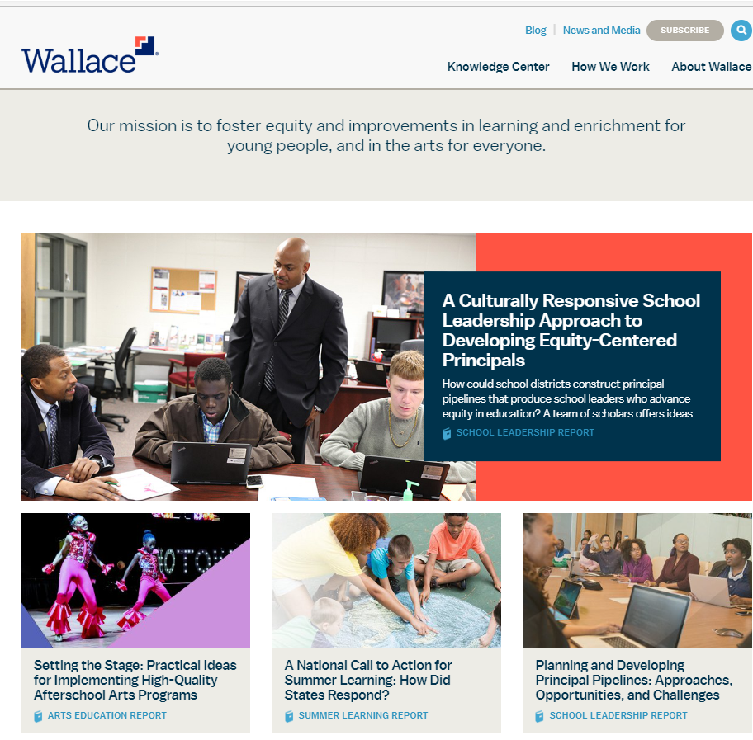
Thank you
Wallace Knowledge Center:
wallacefoundation.org
Will Miller, President, The Wallace Foundation, wmiller@wallacefoundation.org
Kenneth Austin, Vice President, Policy Engagement, The Wallace Foundation, kaustin@wallacefoundation.org
Rotunda Floyd-Cooper, Vice President, Education Leadership, The Wallace Foundation, rfloyd-cooper@wallacefoundation.org
For dozens of research reports available without charge, visit wallacefoundation.org

Slide 24
Appendix

Slide 25
Other examples of how states used federal funding to support principals
Nebraska developed the Tri-City ASCEND Academy among 3 districts in rural Nebraska, and support from regional service agencies and a university.
Winston-Salem/Forsyth County, NC integrated the principal pipeline into its strategic plan and uses ARP funding for principal professional development

Slide 26
Examples: How districts and states used federal funding around summer
Newark used summer learning both for students and for school leader and teacher development, pairing novice teachers with highly-skilled, seasoned teachers
Oregon created a tool to gather youth voices on summer learning to help leaders understand student perceptions, refine programs, and shape decision-making
Tennessee started an Alternative and Aspiring educator training program to create a pipeline for much-needed new teachers for summer programs
Tulsa offered summer learning to every student, partnering with a local out-of-school time intermediary to provide enrichment

