Slide 1
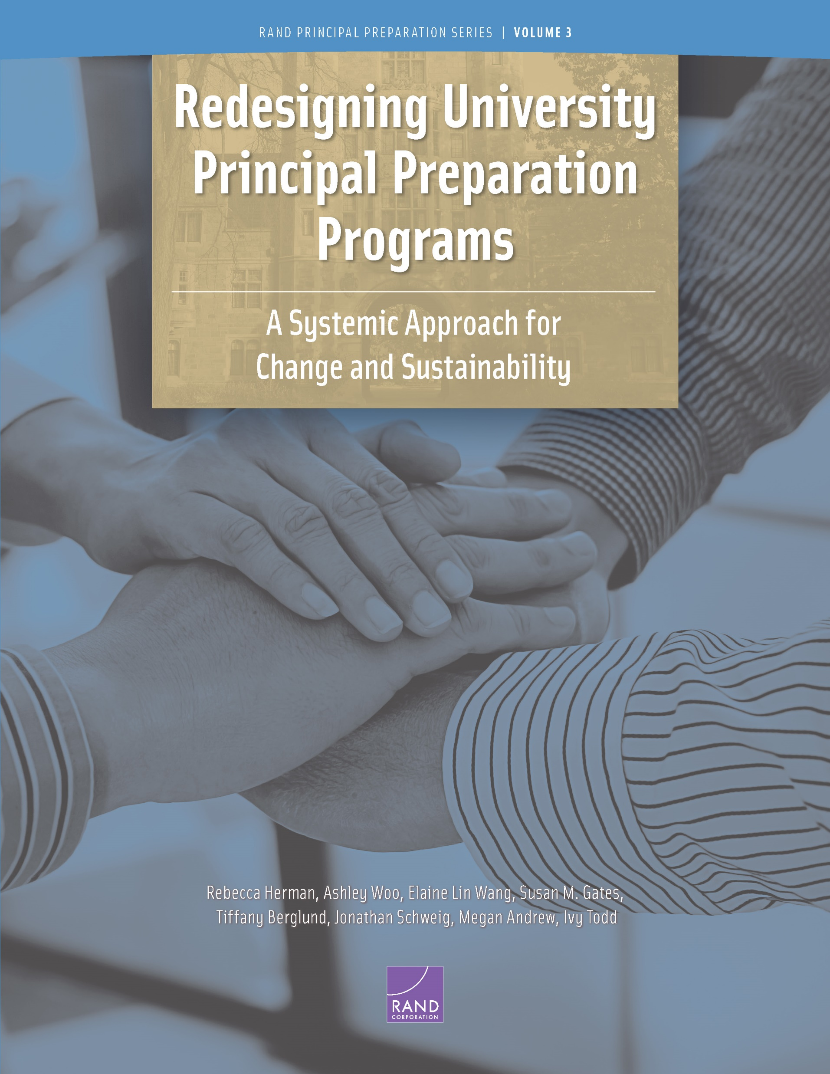
Strengthening the Bench of Principals:
Evidence and Examples from Universities, Districts and States
National webinar
June 6, 2022
1-2:15 p.m. EDT

Slide 2
Housekeeping
This webinar is being recorded
The recording and slides will be posted by Wednesday at wallacefoundation.org
To ask a question, use the Q & A function
The chat function has been disabled for this webinar
For technical help, please e-mail events@thehatchergroup.com

Slide 3
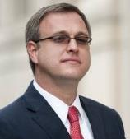
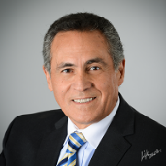
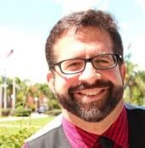
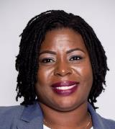
Today’s agenda
Research presentation
  Learning Policy Institute – Developing Effective Principals: What Kind of Learning Matters?
  RAND – Redesigning University Principal Preparation Programs: A Systemic Approach for Change and Sustainability
Panel discussion
  Peter Zamora, Council of Chief State School Officers
  Dan Domenech, AASA, the School Superintendents Association
  Daniel Reyes-Guerra, Florida Atlantic University
  Rashaunda Tyson, Hartford Public Schools, CT
Q & A
Peter Zamora
Dan Domenech
Daniel Reyes-Guerra
Rashaunda Tyson

Slide 4
Developing Effective Principals
What Kind of Learning Matters?
Marjorie Wechsler and Stephanie Levin
June 6, 2022

Slide 5

Principals matter

Slide 6
Research questions and methods
Research question | Primary method
What are the features and outcomes of high-quality principal learning? | Research synthesis
To what extent do principals have access to high-quality learning opportunities? | Survey analysis
What is the role of policy in shaping principal learning? | Policy scan

Slide 7
Comprehensive principal preparation and professional development are positively associated with benefits:
Principals
Perceptions of effectiveness
Attitudes
Skills
Efficacy
Teachers
Satisfaction
Retention
Students
Attendance
Achievement
Graduation rates

Slide 8
Content
Instruction
School improvement
School conditions
Staff development
Meeting students’ needs

Slide 9
Strategies
Applied learning
Internships
Coaching and mentoring
Cohorts and networks

Slide 10
Access to important content in preparation is high, nationally
Over two-thirds of principals had access to all important content areas
  Instructional leadership
  Leading and managing school improvement
  Shaping teaching and learning conditions
  Developing people
  Meeting the needs of learners
Source: National Principal Survey

Slide 11
Access to key content in preparation is increasing
Source: National Principal Survey

Slide 12
Too few principals report access to high-leverage learning opportunities
Source: National Principal Survey

Slide 13
Access differs by school poverty level
Source: National Principal Survey

Slide 14

Policies can support the quality of principal learning and access to it

Slide 15
Policy changes appear to influence principals’ access to learning about key topics…
(California: before & after reforms)
Source: California Principal Survey
Notes:
California’s Overhaul of Principal Licensure provides an example of policy influencing outcomes.
Between 2011 and 2017, licensure and accreditation changes integrated the new national standards and revised state standards in ways that emphasized educating diverse learners from a whole child perspective, integrating social and emotional learning and restorative practices, developing staff, using data, and involving stakeholders for school improvement.
Administrator performance expectations were then translated into program approval standards and new expectations for both preservice training and induction; later, they were translated into an administrator performance assessment.
These changes in expectations guiding program approval and induction were associated with changes in principals’ perceptions of their preparation.
As shown on this slide:
More recently prepared principals had greater access to learning about key topics than veteran principals.
CLICK TO GO TO NEXT SLIDE

Slide 16
… and the extent to which principals feel well-prepared
(California: before & after reforms)
Source: California Principal Survey

Slide 17
Stronger program approval requirements in Illinois produced positive changes in preparation programs
New requirements:
  Program-district partnerships
  Rigorous selection
  Alignment with standards
  Yearlong internship
  Competency-based assessments
Led to positive changes:
  Stronger partnerships
  Shift from quantity to quality in recruitment and enrollment
  Revamped curriculum
  Greater attention to diversity
  More meaningful internships
  Focus on continuous improvement

Slide 18
States generally do not legislate high-leverage policies
Yet…
Program approval criteria | Principal licensure criteria
Proactive candidate recruitment & selection* Clinically-rich internships* Strong IHE-district partnerships* Regular state oversight with feedback* Use of school leadership standards | Experience and education requirements* Assessment including portfolio review License renewal with continuing education
Only two states met criteria for all 5 high-leverage policies
11 states did not meet any
State policies are more likely to focus on principal licensure than higher-leverage program approval
* = high leverage
Source: Anderson & Reynolds (2015)

Slide 19
Implications for policy and research
Develop and better use state licensing and program approval standards
Invest in a statewide infrastructure
Encourage greater attention to equity
Build local pipelines
Invest in methodologically strong research about principal learning

Slide 21


THE UNIVERSITY
PRINCIPAL PREPARATION
INITIATIVE (UPPI)
A SYSTEMIC APPROACH FOR
CHANGE AND SUSTAINABLITY
Rebecca Herman, Susan M. Gates, and Elaine Lin Wang
June 6, 2022

Slide 22
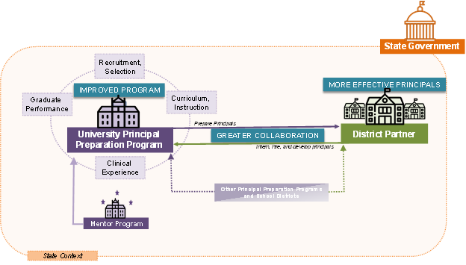
UPPI leveraged partnerships around program improvement
Other Principals Preparation
Programs and School Districts

Slide 23
UPPI launched in 2016
Seven universities and their partners implemented the initiative
University of
Connecticut
(UCONN)
San Diego State
University (SDSU)
Virginia State
University (VSU)
Western Kentucky
University (WKU)
North Carolina State
University (NC State)
Florida Atlantic
University (FAU)
Albany State
University (ASU)

Slide 24
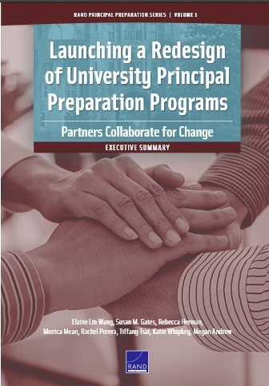
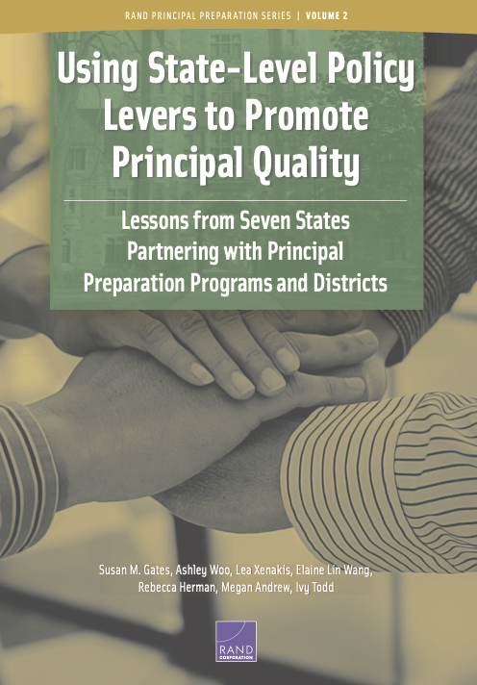

UPPI Study Reports
Final Report
(cover is notional)
Final
Report
Briefs for district, state and university leaders
2018
2020
2022
Year 1 of program redesign
The state role
in promoting principal quality
Feasibility, strategies, and interplay between universities, district and states

Slide 25

Final report data
Over 630 data collection activities
Biennial Site Visits from 2017 to 2021*
Interviews
Focus groups
Observation of UPPI Leadership Team meetings
Collection of documents
Regular Check-ins April 2017 to December 2020
Project director and district leads
*Due to the COVID-19 pandemic, site visits were conducted virtually Spring 2020-Spring 2021, and with reduced data collection activities Spring and Fall 2020.

Slide 26
Preview of key findings
1
2
3
UPPI teams
improved the coherence
of the programs
The universities used partnerships and supports to conceptualize and carry out program changes
Partners took the UPPI test-bed strategies
beyond the UPPI program

Slide 27
1
2
3
UPPI teams
improved the coherence
of the programs
The universities used partnerships and supports to conceptualize and carry out changes
to the programs
Partners took the UPPI test-bed strategies
beyond the UPPI program

Slide 28
Universities improved program coherence
Each site used an overarching framework to guide curriculum redesign
Each used a set course sequence to support principal candidates’ learning
Each aligned instructional programs to national standards and state requirements
Clinical components were strengthened, personalized and aligned with evidence-based features of successful principal preparation programs

Slide 29
Programs engaged with districts to make recruiting more collaborative and targeted
Greater district involvement in nominating and selecting applicants
Targeted recruitment to attract candidates with specific qualifications
More performance-based tasks in the application and selection processes

Slide 30
UPPI programs strengthened the use of cohorts
Cohorts supported program coherence and helped candidates succeed on milestone and anchor assessments and likely in their future roles
Candidates developed a peer support network to sustain them after the program

Slide 31
1
2
3
UPPI teams
improved the coherence
of the programs
The universities used partnerships and supports to conceptualize and carry out changes
to the programs
Partners took the UPPI test-bed strategies
beyond the UPPI program

Slide 32
Four collaborative partners played active roles in all stages of the redesign process
University
District
State
Mentor Program
Managed overall redesign Led steering groups and most working groups | Led development of district Leader Tracking Systems Served on steering and working groups | Policy guidance and convened programs statewide Served on steering and some working groups | Provided technical assistance Served on steering and working groups

Slide 33
Program self-assessments and logic model development helped the teams work together, kept the process on track
The Quality Measures (QM) self-assessment helped programs identify gaps and track progress in addressing them
Common vision, activities and tools helped each team build and revise their frameworks
Mentor programs supported UPPI redesign, according to the needs of the university and its stage in the redesign
33

Slide 34
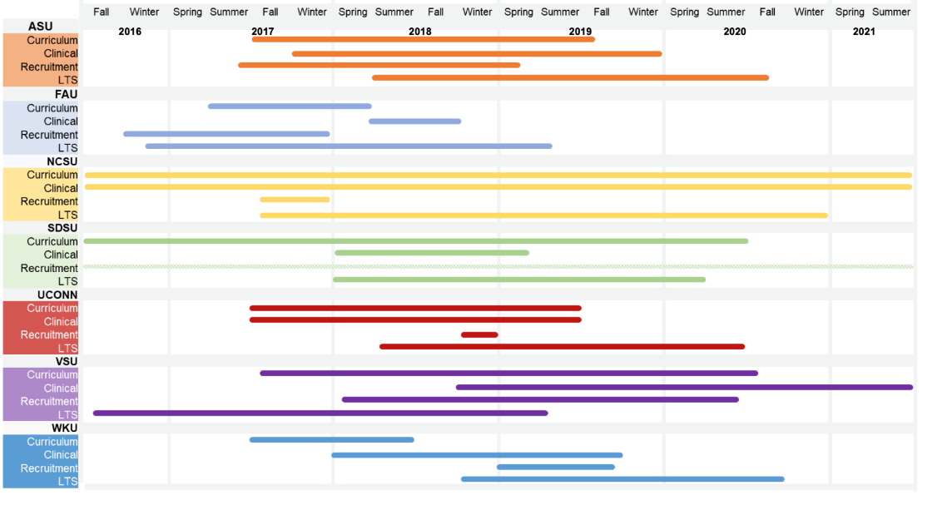
There was no single way to sequence the redesign work
Development Timeline by Site and Component

Slide 35
Key features were crucial to successful implementation
Instructors with a deep understanding of and commitment to the program in place prior to implementation
Coordination meetings and training, and other steps
Program coordinators or cohort directors to facilitate implementation, especially for clinical elements

Slide 36
Continuous improvement was built into the redesign and implementation processes
Sites recognized that redesign was not a “one-and-done” process
Intentionally collecting and using multiple forms of data to guide improvement
Data helped improve course sequencing and reduce redundancies in the curriculum
Teams took steps to institutionalize the redesign features as well as the partnership and process of continuous improvement:
Hard funding for new program positions
Shared – not individual – ownership of the curriculum
External advisory groups and internal processes
Documentation
Teams used advisory groups and within-program processes.

Slide 37
Leader tracking systems (LTS) helped both districts and universities in five ways
 | Use of Leader Tracking Systems
 | Preparation program continuous improvement | Applicant and candidate support | Hiring and placing principals | Leadership development | Leadership pipeline planning
Leader Tracking Systems drew on 10 sources of data including school characteristics, candidate demographics, program quality and graduate placement

Slide 38
1
2
3
UPPI teams
improved the coherence
of the programs
The universities used partnerships and supports to conceptualize and carry out changes
to the programs
Partners took the UPPI
test-bed strategies
beyond the UPPI program

Slide 39
Universities expanded upon lessons learned
Universities scaled up their redesigned programs by offering additional districts partnership opportunities
They used the revised curriculum to develop new programs for other stages of the pathway – teacher leaders, recent program graduates or principal supervisors

Slide 40
Districts strengthened their own principal supports
Partner districts revised district leader standards, principal and AP evaluation and job descriptions to align with UPPI program content
Partner districts created new programs or professional development opportunities for district staff aligned with UPPI program content

Slide 41
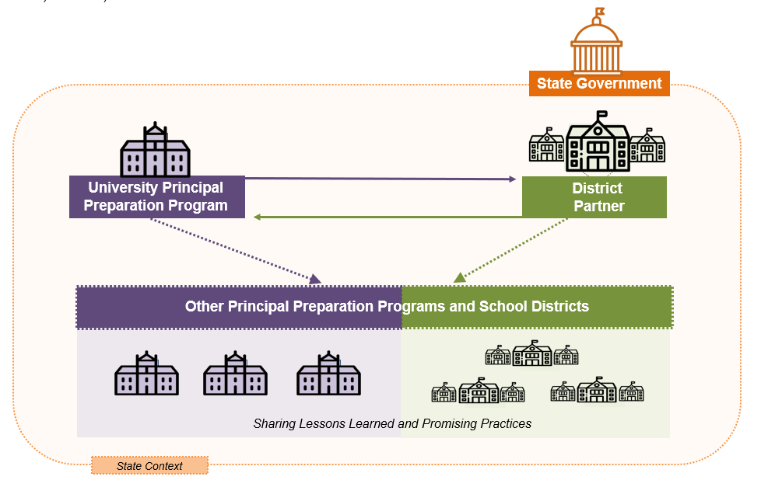
States improved policy and disseminated lessons statewide
UPPI states continued to improve principal preparation policy statewide, using seven policy levers, including:
  PD opportunities for aspiring principals, principals, faculty, clinical coaches, mentor principals
  New licensure requirements
  Applying updated standards to professional learning and principal evaluation
States also convened other universities and districts to share lessons

Slide 42
Lessons Learned
1
2
3
UPPI teams
improved the coherence
of the programs
The universities used partnerships and supports to conceptualize and carry out program changes
Partners took the UPPI test-bed strategies
beyond the UPPI program

Slide 43
There are viable strategies to address common challenges
Time to carry out the redesign work
Turnover at all levels
  Buy out faculty time
  Meet at non-traditional times
  Embed the district work in district strategic plans
  Onboarding
  Redundant staffing and cross-training
  Documentation
New model for faculty sharing courses
  Ownership through collaborative development
  Professional learning for faculty
  Shift MA courses to adjuncts and PhD to tenure-track faculty
Notes:
majr

Slide 44
UPPI provides a model for collaboratively redesigning university principal preparation programs, with space for tailoring to context
By partnering with districts, state agencies, and mentor programs — universities can redesign their preparation programs to reflect the best available evidence
Redesign required collaborative partnerships; programs are part of a larger system
Developing a clear and ambitious vision is critical
States strengthened policies supporting principals, and shared lessons broadly
Teams balanced common objectives and structure with flexibility

Slide 45
THANK YOU

Slide 46
Universities, districts and states all matter in preparing and supporting effective principals
We’ve learned what content and learning approaches are most important, and opportunities for principal learning have improved over the decade
  But access to high-quality principal learning remains inconsistent, varying by state and school poverty level, according to the LPI synthesis
States and districts can take action to boost access
  States: Update leader standards, program approval, principal licensure, academies, funding internships, attending to equity, spreading effective practices statewide
  Districts: Collaborate on selection and tapping of candidates, mentors and coaches, build principal pipelines, data and networking
Universities, states and districts that work together can redesign their preparation programs to be more coherent and reflect effective practices
  This approach can be a model for others, RAND found

Slide 47

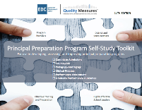
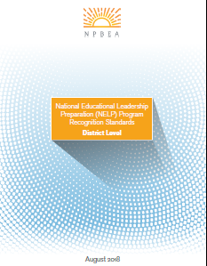
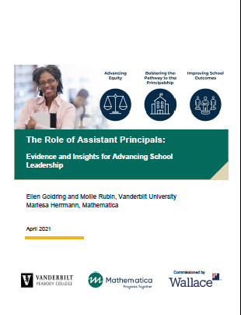
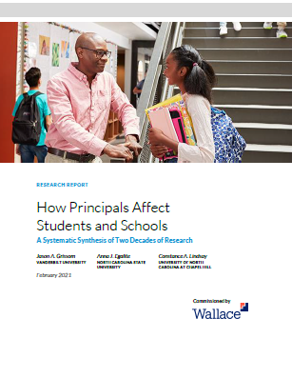
Thank you!
Learn more:
ccsso.org
learningpolicyinstitute.org
npbea.org
rand.org
wallacefoundation.org
Learningpolicyinstitute.org or wallacefoundation.org
rand.org or wallacefoundation.org
To access these resources, click on the cover
edc.org or wallacefoundation.org
npbea.org
npbea.org
Mathematica.org or wallacefoundation.org
wallacefoundation.org

