Slide 1


Education Leadership: Evidence and Implications
Principal Elizabeth Namba, right, visits a classroom at Hyde-Addison Elementary in Washington, D.C. as Principal supervisor Janice Harris, at rear, observes.
Will Miller
President, The Wallace Foundation
Technical Assistance Briefing for U.S. House Committee on Education and Labor
April 11, 2019

Slide 2
Introductions
Sarah Reeves, principal, Shamrock Gardens Elementary, Charlotte-Mecklenburg Public Schools, North Carolina
Douglas Anthony, associate superintendent, office of talent development, Prince George’s County Public Schools
Douglas Fisher, director, education leadership, San Diego State University
Mary Ellen Elia, commissioner, New York State Department of Education

Slide 3
Today’s discussion
The Wallace Foundation
Impact of principals and other school leaders and the importance of their preparation
New evidence that principal pipelines are a major strategy for improving student achievement districtwide
How states are investing in strengthening school leadership and using ESSA to do it
Specific HEA legislative recommendations
Discussion, Q&A

Slide 4

About The Wallace Foundation
The mission of The Wallace Foundation is to foster
  improvements in learning and enrichment for disadvantaged children and
  the vitality of the arts for everyone.
We work with grantee partners to develop -- then broadly share -- evidence-based, practical, effective approaches in our focus areas

Slide 5
Wallace’s policy engagement principles
Full compliance with the law, in letter and spirit
Say more only as we know more
Support flexible approaches that allow for adaptation to local context

Slide 6
Current work in education leadership in 20 states and Washington, D.C.
Minnesota
New York
Oregon
Wisconsin
Connecticut
Pennsylvania
Nebraska
Iowa
Ohio
Maryland
Virginia
D.C.
Colorado
Kentucky
North
Carolina
Missouri
California
Tennessee
Oklahoma
Georgia
Florida

Slide 7
Today’s discussion
The Wallace Foundation
Impact of principals and other school leaders and the importance of their preparation
New evidence that principal pipelines are a major strategy for improving student achievement districtwide
How states are investing in strengthening school leadership and using ESSA to do it
Specific HEA legislative recommendations
Discussion, Q&A

Slide 8
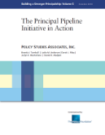




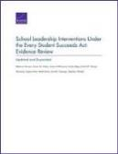



Wallace has funded a wide array of research on school leadership over two decades

Slide 9

Effective principals matter for student learning
Principals are “second only to classroom instruction among all school-related factors that contribute to what students learn at school.”
      -- How Leadership Influences Student Learning, Kenneth Leithwood, et al, University of Minnesota, University of Toronto, 2004
“Principals are multipliers of effective teaching.”
      -- Developing Excellent School Principals to Advance Teaching and Learning: Considerations for State Policy, Paul Manna, The Wallace Foundation, 2015
New voluntary, professional standards for principals reflect this new research and a new understanding of the role
The Professional Standards for Educational Leaders are an updated set of voluntary, evidence-based professional standards for the job that spell out 10 essentials, including the ability to support rigorous instruction.​​

Slide 10
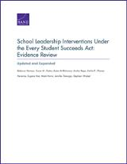

Principals are key to retaining good teachers
“Teacher turnover is lower in schools led by high-quality principals…. Research further indicates that principal turnover leads to lower teacher retention and lower gains for students.”
  -- School Leadership Interventions Under the
  Every Student Succeeds Act: Evidence Review,
  Rebecca Herman, et al, RAND, 2016
“Principal effectiveness is associated with greater teacher satisfaction and a lower probability that the teacher leaves the school within a year. Moreover, the positive impacts of principal effectiveness on these teacher outcomes are even greater in disadvantaged schools.”
  -- Can Good Principals Keep Teachers in Disadvantaged Schools? Linking Principal Effectiveness to Teacher Satisfaction and Turnover in Hard-to-Staff Environments, Jason A. Grissom, Teachers College Record, 2011

Slide 11
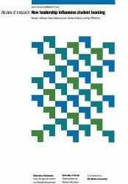
Principals are critical to improving struggling schools
“…there are virtually no documented instances of troubled schools being turned around without intervention by a powerful leader. Many other factors may contribute to such turnarounds, but leadership is the catalyst.”
“There seems little doubt that both district and school leadership provides a critical bridge between most educational-reform initiatives, and having those reforms make a genuine difference for all students.”
    -- How Leadership Influences Student Learning, Kenneth Leithwood, et al, University of Minnesota, University of Toronto, 2004

Slide 12
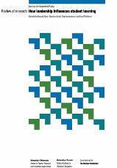
Investing in principals is cost-effective
Because of leaders’ influence on schools, “efforts to improve their recruitment, training, evaluation and ongoing development should be considered highly cost-effective approaches to successful school improvement.”
          – How Leadership Influences Student Learning, Kenneth Leithwood, et al, University of Minnesota, University of Toronto, 2004

Slide 13
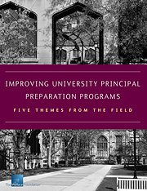
Principal preparation: Districts and universities cite need for improvement
District leaders are largely dissatisfied with the quality of principal preparation programs, and many universities believe that their programs have room for improvement.
Strong university-district partnerships are essential to high-quality preparation but are far from universal.
The course of study at preparation programs does not always reflect principals’ real jobs.
Some university policies and practices can hinder change.
States have authority to play a role in improving principal preparation, but many are not using this power as effectively as possible.
    Source: Improving University Principal Preparation Programs: Five Themes from the Field, Jacquelyn Davis, The Wallace Foundation, 2016.

Slide 14

2018 RAND study provides early lessons on principal preparation redesign
Based on a study of seven universities in Wallace’s University Principal Preparation Initiative, RAND found:
  On-going partnerships with districts are essential
  Benchmarking against evidence-based best practices challenges long-held assumptions
  Local Theories of Action and Logic Models help clarify mutual visions and program/district goals
  Convening teams across the initiative provides critical friends feedback and a sense of larger national importance
  Project leadership is important; support at high levels needed
Participating teams
Albany State University, GA
Florida Atlantic University
North Carolina State University
San Diego State University
University of Connecticut
Virginia State University
Western Kentucky State University
Source: Launching a Redesign of University Principal Preparation Programs: Partners Collaborate for Change, RAND, 2018

Slide 15
Today’s discussion
The Wallace Foundation
Impact of principals and other school leaders and the importance of their preparation
New evidence that principal pipelines are a major strategy for improving student achievement districtwide
How states are investing in strengthening school leadership and using ESSA to do it
Specific HEA legislative recommendations
Discussion, Q&A

Slide 16
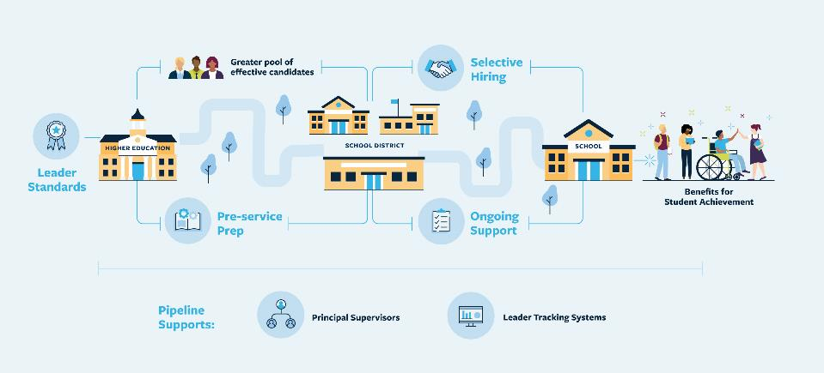
Pipelines are a strategic approach to developing and supporting principals

Slide 17






Districts in the Principal Pipeline Initiative

Slide 18

Pipelines had widespread, positive effect on student achievement
Outperformance in math for elementary, middle and high school; for reading in elementary and middle school
Pipelines benefited all schools in a district, not just those with pipeline principals
Notably, effects were positive and statistically significant for schools in the lowest quartile of student achievement
Benefits kicked in early, even beginning in the second year of implementation
“We found no other comprehensive district-wide initiatives with demonstrated positive effects of this magnitude on achievement.”
  --Principal Pipelines: A Feasible, Affordable, and Effective Way for Districts to Improve Schools, RAND, 2019

Slide 19
Pipelines also reduced principal turnover
Principal turnover is costly for districts ($75,000 per principal) and disruptive for schools
For every 100 new principals, pipeline districts saw nearly 6 fewer losses after two years and nearly 8 fewer losses after three years, compared with similar schools getting new principals in other districts in their state

Slide 20
Pipelines are feasible and adaptable
All six districts were able to implement the pipeline components aligned and at scale
Each district adapted pipelines to their own local context

Slide 21
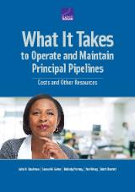
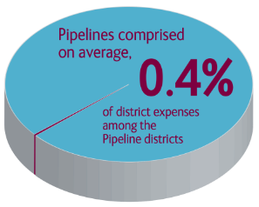
Pipelines are affordable
Pipelines are 0.4% of annual district budgets, according to a RAND study of the six districts in the initiative
Minimal cost for two “quick wins” – leader standards and selective hiring
Coaching/Mentoring: Average cost $1,500 per principal
Source: What It Takes to Operate and Maintain Principal Pipelines, Julia H. Kaufman, et al, 2017

Slide 22
Pipelines can be sustained – and continuously improved
Two years after Wallace funding ended all six districts continued to support pipelines with local funding
During the initiative, about 30% of funding came from Wallace, mostly for one-time investments in system supports
Pre-service preparation improved with greater emphasis on instruction
  Job standards remained foundational to principals’ development
Sustaining a Principal Pipeline, Brenda Turnbull, Policy Studies Associates, 2019

Slide 23
Today’s discussion
The Wallace Foundation
Impact of principals and other school leaders and the importance of their preparation
New evidence that principal pipelines are a major strategy for improving student achievement districtwide
How states are investing in strengthening school leadership and using ESSA to do it
Specific HEA legislative recommendations
Discussion, Q&A

Slide 24
Growing recognition of the importance of school leadership
48 states have adopted or adapted voluntary national leader standards
  12 states have adopted the 2015 national Professional Standards for Educational Leaders (PSEL)
  At least 8 additional states have committees working on adoption or adaptation of PSEL
The Education Commission of the States reports that 36 states introduced or passed legislation related to school leadership in 2018
  22 states have enacted legislation

Slide 25

New study by Policy Studies Associates shows leadership as an emerging priority under ESSA
Based on responses from 39 states
  Sixty-nine percent of SEAs are using school leadership as a strategy to improve the highest-needs schools
    Only 24 percent reported having made substantial progress on this goal already
  But relatively few states (20%) report using leader preparation as a strategy for strengthening school leadership
    80 percent used strategies to support sitting principals as opposed to preparing and supporting principals – making this an opportunity for states to apply the evidence about principal pipelines
24 states are using ESSA Title II Part A optional 3% set-aside for school leadership
“School leadership stands out as an emerging priority for SEAs.”
Sustaining a Principal Pipeline, Brenda Turnbull, Policy Studies Associates, 2019; Council of Chief State School Officers

Slide 26
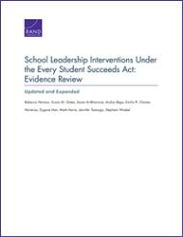
30+ studies on school leadership meet ESSA evidence requirements
18 meet Tiers I through III evidence requirements
Key conclusions:
  “School leadership can be a powerful driver of improved education outcomes.”
  “Activities designed to improve school leadership demonstrate positive impact on student, teacher, and principal outcomes….”
Source: School Leadership Interventions Under the Every Student Succeeds Act Evidence Review, Rebecca Herman, et al, RAND, 2016

Slide 27

Principal pipelines meet ESSA’s evidence requirements for school improvement
Abt Associates review finds RAND’s study of principal pipelines meets:
  Tier II designation for student achievement
  Tier III designation for principal retention
ESSA Evidence Review of the Principal Pipeline Initiative, Brenda Turnbull, Abt Associates, 2019

Slide 28
Today’s discussion
The Wallace Foundation
Impact of principals and other school leaders and their preparation
New evidence that principal pipelines are a major strategy for improving student achievement districtwide
How states are investing in strengthening school leadership and using ESSA to do it
Specific HEA legislative recommendations
Discussion, Q&A

Slide 29

HEA can help scale effective leader preparation through evidence and tools
Most principals receive their leadership training from university programs
Both superintendents and university officials agree that those programs need to be improved to better reflect the reality of the job today
  Strong district/university partnerships are essential (and rare)
  Courses need to be based on the reality of the job
Aspiring principals in Denver’s Ritchie Program for school leaders take part in an exercise to hone their skills in communicating with teachers.
Source: Improving University Principal Preparation Programs, Jacquelyn Davis, The Wallace Foundation, 2016; Principal Preparation Program Self-Study Toolkit, 10th edition, C. King, 2018.

Slide 30
Specific legislative recommendations for HEA Title II, Part A
Include the phrase “principals and other school leaders” in addition to “teachers,” as was done in the Every Student Succeeds Act
Provide additional flexibility and options to states and universities to prioritize education leadership by ensuring that eligible entities have the option to focus their HEA Title II, Part A grant on leader preparation activities, teacher preparation activities, or a combination of both
    Clarify that for competitive partnership grants, support for improved preparation of principals and other school leaders can include support for principal pipelines
HEA text that defines specific supports for teachers should include definitions applicable to leaders
  E.g., induction programs, mentoring, and residency programs
Notes:
A copy of a mark-up by Wallace was provided to the House Education Labor Committee at its request.

Slide 31
Introductions
Sarah Reeves, principal, Shamrock Gardens Elementary, Charlotte-Mecklenburg Public Schools, North Carolina
Douglas Anthony, associate superintendent, office of talent development, Prince George’s County Public Schools
Douglas Fisher, director, education leadership, San Diego State University
Mary Ellen Elia, commissioner, New York State Department of Education

Slide 32
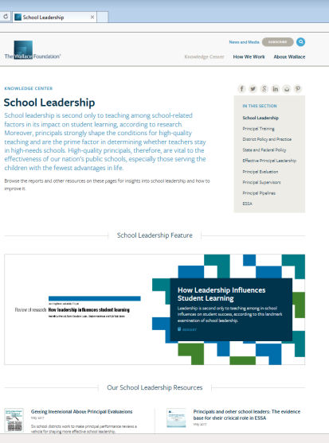
For more evidence and information – wallacefoundation.org

Slide 33
Summary
Context:
  Evidence shows that effective principals and other school leaders are crucial to school improvement, are key to retaining good teachers – and that investing in them is cost-effective
  Effective principal preparation of principals and other school leaders is therefore important
  Among 39 states responding to a survey, two-thirds report that improving low-performing schools through improved leadership is a top-three priority
  New evidence confirms principal pipelines – a systematic approach to developing and supporting novice principals at the scale of an entire large district – as an effective strategy to achieve district-wide school improvement, particularly for schools in the lowest quartile of achievement
As Congress considers HEA reauthorization, our two key recommendations are:
    Make explicit that both teacher and leader preparation, are each separately eligible for funding under HEA, or in combination
    Clarify that for competitive partnership grants, support for improved preparation of principals and other school leaders can include support for principal pipelines

